Slide 1
Transport Layer:
Process to Process Communication/(End-End)/(Port-Port)
User Datagram Protocol (UDP)
Transmission Control Protocol (TCP)
SCTP
Congestion Control
Quality of Service
QoS improving techniques: Leaky Bucket and Token Bucket algorithm.

Slide 2
The transport layer is responsible for process-to-process delivery of the entire message.
A process is an application program running on a host.
Computers often run several programs at the same time. For this reason, source-to-destination delivery means delivery not only from one computer to the next but also from a specific process on one computer to a specific process on the other.
The transport layer header must therefore include a type of address called a service-point address in the OSI model and port number or port addresses in the Internet and TCP/IP protocol suite.

Slide 3
A transport layer protocol can be either connectionless or connection-oriented.
A connectionless transport layer protocol such as UDP treats each segment as an independent packet and delivers it to the transport layer at the destination machine.
A connection-oriented transport layer protocol such as TCP and SCTP(Stream Control Transmission Protocol) makes a connection with the transport layer at the destination machine first before delivering the packets. After all the data is transferred, the connection is terminated.
UDP, is not involved in flow or error control, TCP and SCTP, use sliding windows for flow control and an acknowledgment system for error control
Socket Addresses
Process-to-process delivery needs two identifiers, IP address and the port number, at each end to make a connection. The combination of an IP address and a port number is called a socket address

Slide 4
LET US CONSIDER A NETWORK AS, A------B------C------D------E AND A IS SENDING MESSAGE TO E
IN THIS
A is source and E is Destination....
Hosts are A and E
Hops or Nodes are A,B,C,D,E
Ends are the processes in layers which are communicating ( web processes in Transport Layer of 'A' communicating with web processes in Transport Layer of 'B' )
therefore
hop-to-hop(node-to-node) by Data Link Layer( MAC address)
Host-to-Host is Network Layer(IP Address)
End-to-End(process-to-process) is Transport Layer(port number)16bit no

Slide 5
Responsibilities of a Transport Layer
1) Process to process delivery
While Data Link Layer requires the MAC address of source-destination hosts to correctly deliver a frame and Network layer requires the IP address for appropriate routing of packets , in a similar way Transport Layer requires a Port number to correctly deliver the segments of data to the correct process amongst the multiple processes running on a particular host. A port number is a well, address used to identify any client-server program uniquely.
lANA(Internet Assigned Number Authority )Ranges
The lANA has divided the port numbers into three ranges:
Well known port numbers
Registered port numbers
dynamic (or private) port numbers

Slide 6
o Well-known ports
The ports ranging from 0 to 1023 are assigned and controlled by lANA. These are called the well-known ports.
o Registered ports
The ports ranging from 1024 to 49,151 are not assigned or controlled by lANA. They can only be registered with lANA to prevent duplication.
o Dynamic ports/Private Ports
The ports ranging from 49,152 to 65,535 are neither controlled nor registered. They can be used by any process.

Slide 7
End-to-end Connection between hosts
The transport layer is also responsible for creating the end-to-end Connection between hosts for which it mainly uses TCP and UDP. TCP is a secure, connection- orientated protocol which uses a handshake protocol to establish a robust connection between two end- hosts. TCP ensures reliable delivery of messages and is used in various applications. UDP, on the other hand, is a stateless and unreliable protocol which ensures best-effort delivery. It is suitable for the applications which have little concern with flow or error control.
Multiplexing and De-multiplexing
Multiplexing is when data is acquired from several processes from the sender and merged into one packet along with headers and sent as a single packet. Multiplexing allows the simultaneous use of different processes over a network that is running on a host. The processes are differentiated by their port numbers. Similarly, Demultiplexing(one to many) is required at the receiver side when the message is distributed into different processes. Transport receives the segments of data from the network layer distributes and delivers it to the appropriate process running on the receiver’s machine.

Slide 8
Congestion Control
Congestion is a situation in which too many sources over a network attempt to send data and the router buffers start overflowing due to which loss of packets occurs. As a result, the retransmission of packets from the sources increases the congestion further.
In this situation, the Transport layer provides Congestion Control in different ways. It uses open-loop congestion control to prevent congestion and closed-loop congestion control to remove the congestion in a network once it occurred.
Data integrity and Error Correction
The transport layer checks for errors in the messages coming from the application layer by using error detection codes, and computing checksums, it checks whether the received data is not corrupted and uses the ACK and NACK services to inform the sender if the data has arrived or not and checks for the integrity of data.

Slide 9
Flow Control
The transport layer provides a flow control mechanism between the adjacent layers of the TCP/IP model. TCP also prevents data loss due to a fast sender and slow receiver by imposing some flow control techniques. It uses the method of sliding window protocol which is accomplished by the receiver by sending a window back to the sender informing the size of data it can receive.
Connectionless Versus Connection-Oriented Service
Reliable Versus Unreliable

Slide 10
Transport Layer Protocols
TCP(Transmission Control Protocol)
UDP( User Datagram Protocol)
SCTP (Stream Control Transmission Protocol)
Stream Control Transmission Protocol (SCTP) is a connection-oriented network protocol for transmitting multiple streams of data simultaneously between two endpoints that have established a connection in a computer network.

Slide 11
TCP Services
Process-to-Process Communication
TCP provides process-to-process communication using port numbers.
Reliable
TCP is a reliable protocol as it follows the flow and error control mechanism. It also supports the acknowledgment mechanism, which checks the state and sound arrival of the data. In the acknowledgment mechanism, the receiver sends either positive or negative acknowledgment to the sender so that the sender can get to know whether the data packet has been received or needs to resend.
Order of the data is maintained
This protocol ensures that the data reaches the intended receiver in the same order in which it is sent. It orders and numbers each segment so that the TCP layer on the destination side can reassemble them based on their ordering.

Slide 12
Connection-oriented
It is a connection-oriented service that means the data exchange occurs only after the connection establishment. When the data transfer is completed, then the connection will get terminated.
Full duplex
It is a full-duplex means that the data can transfer in both directions at the same time
Stream-oriented
TCP is a stream-oriented protocol as it allows the sender to send the data in the form of a stream of bytes and also allows the receiver to accept the data in the form of a stream of bytes. TCP creates an environment in which both the sender and receiver are connected by an imaginary tube known as a virtual circuit. This virtual circuit carries the stream of bytes across the internet.

Slide 13
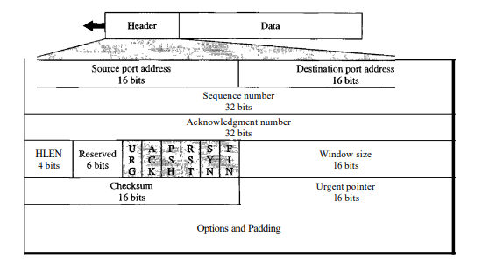
TCP Segment
A packet in TCP is called a segment.
Format
The format of a segment is shown below

Slide 14
Source port address. This is a 16-bit field that defines the port number of the application program in the host that is sending the segment.
Destination port address. This is a 16-bit field that defines the port number of the application program in the host that is receiving the segment.
Sequence number. This 32-bit field defines the number assigned to the first byte of data contained in this segment. As we said before, TCP is a stream transport protocol. To ensure connectivity, each byte to be transmitted is numbered. The sequence number tells the destination which byte in this sequence comprises the first byte in the segment. During connection establishment, each party uses a random number generator to create an initial sequence number (ISN), which is usually different in each direction.
Acknowledgment number. This 32-bit field defines the byte number that the receiver of the segment is expecting to receive from the other party. If the receiver of the segment has successfully received byte number x from the other party, it defines x + I as the acknowledgment number. Acknowledgment and data can be piggybacked together.

Slide 15
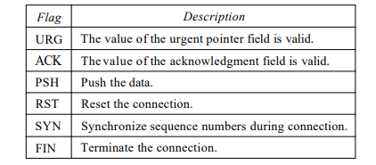
Header length. This 4-bit field indicates the number of 4-byte words in the TCP header. The length of the header can be between 20 and 60 bytes. Therefore, the value of this field can be between 5 (5 x 4 =20) and 15 (15 x 4 =60).
Reserved. This is a 6-bit field reserved for future use.
Control. This field defines 6 different control bits or flags

Slide 16
Window size. This field defines the size of the window, in bytes, that the other party must maintain. Note that the length of this field is 16 bits, which means that the maximum size of the window is 65,535 bytes. This value is normally referred to as the receiving window (rwnd) and is determined by the receiver. The sender must obey the dictation of the receiver in this case.
Checksum. This 16-bit field contains the checksum. The inclusion of the checksum in the UDP datagram is optional, whereas the inclusion of the checksum for TCP is mandatory.
Urgent pointer. This l6-bit field, which is valid only if the urgent flag is set, is used when the segment contains urgent data. It defines the number that must be added to the sequence number to obtain the number of the last urgent byte in the data section of the segment.
Options. There can be up to 40 bytes of optional information in the TCP header.

Slide 17
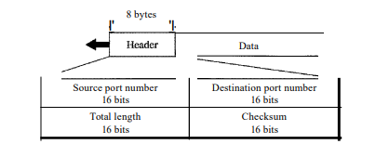
USER DATAGRAM PROTOCOL (UDP)
The User Datagram Protocol (UDP) is called a connectionless, unreliable transport protocol.
UDP is a very simple protocol using a minimum of overhead. If a process wants to send a small message and does not care much about reliability, it can use UDP.
Sending a small message by using UDP takes much less interaction between the sender and receiver than using TCP or SCTP.
UDP packets, called user datagrams, have a fixed-size header of 8 bytes.

Slide 18
Source port number: This is the port number used by the process running on the source host. It is 16 bits long, which means that the port number can range from 0 to 65,535.
Destination port number: This is the port number used by the process running on the destination host. It is also 16 bits long. If the destination host is the server (a client sending a request), the port number, in most cases, is a well-known port number.
Total Length: This is a 16-bit field that defines the total length of the user datagram header plus data. The 16 bits can define a total length of 0 to 65,535 bytes. However, the total length needs to be much less because a UDP user datagram is stored in an IP datagram with a total length of 65,535 bytes.
Checksum: This field is used to detect errors over the entire user datagram (header plus data).Checksum is calculated by using UDP header+UDP Data+Psuedoheader

Slide 19
UDP Operation
UDP uses concepts common to the transport layer.
Connectionless Services: As mentioned previously, UDP provides a connectionless service. This means that each user datagram sent by UDP is an independent datagram. There is no relationship between the different user datagrams even if they are coming from the same source process and going to the same destination program. The user datagrams are not numbered. Also, there is no connection establishment and no connection termination, as is the case for TCP.
Flow and Error Control
There is no flow control and hence no window mechanism. The receiver may overflow with incoming messages.
There is no error control mechanism in UDP except for the checksum. This means that the sender does not know if a message has been lost or duplicated. When the receiver detects an error through the checksum, the user datagram is silently discarded. The lack of flow control and error control means that the process using UDP should provide these mechanisms.

Slide 20
Encapsulation and Decapsulation
To send a message from one process to another, the UDP protocol encapsulates and decapsulates messages in an IP datagram.

Slide 21
Use of UDP
The following lists some uses of the UDP protocol:
o UDP is suitable for a process that requires simple request-response communication with little concern for flow and error control.
o UDP is suitable for a process with internal flow and error control mechanisms.
o UDP is a suitable transport protocol for multicasting. Multicasting capability is embedded in the UDP software but not in the TCP software.
o UDP is used for management processes such as SNMP
o UDP is used for some route updating protocols such as Routing Information Protocol (RIP)

Slide 22
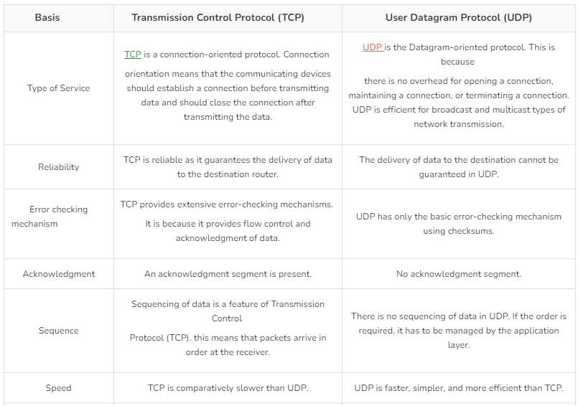

Slide 23
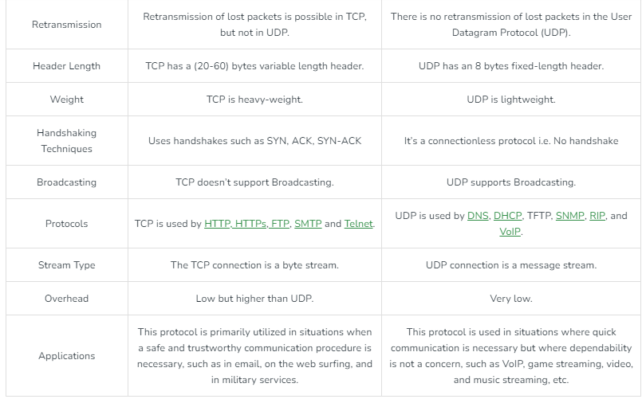

Slide 24
TCP Connection
It requires three phases: connection establishment, data transfer, and connection termination.
Connection Establishment
TCP transmits data in full-duplex mode. When two TCPs in two machines are connected, they are able to send segments to each other simultaneously. This implies that each party must initialize communication and get approval from the other party before any data are transferred.
The connection establishment in TCP is called three-way handshaking.

Slide 25
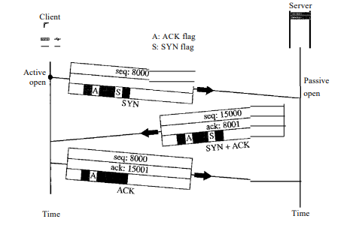
For this process, consider two time lines: one at each site. Each segment has values for all its header fields and perhaps for some of its option fields, too. However, we show only the few fields necessary to understand each phase. We show the sequence number, the acknowledgment number, the control flags (only those that are set), and the window size, if not empty.
The three steps in this phase are as follows.

Slide 26
1.The client sends the first segment, a SYN segment, in which only the SYN flag is set. This segment is for synchronization of sequence numbers. It consumes one sequence number. When the data transfer starts, the sequence number is incremented by 1. We can say that the SYN segment carries no real data, but we can think of it as containing 1 imaginary byte.
2.The server sends the second segment, a SYN + ACK segment, with 2 flag bits set: SYN and ACK. This segment has a dual purpose. It is a SYN segment for communication in the other direction and serves as the acknowledgment for the SYN segment. It consumes one sequence number
3.The client sends the third segment. This is just an ACK segment. It acknowledges the receipt of the second segment with the ACK flag and acknowledgment number field. Note that the sequence number in this segment is the same as the one in the SYN segment; the ACK segment does not consume any sequence numbers.

Slide 27
Simultaneous Open A rare situation, called a simultaneous open, may occur when both processes issue an active open. In this case, both TCPs transmit a SYN + ACK segment to each other, and one single connection is established between them.
SYN Flooding Attack :This happens when a malicious attacker sends a large number of SYN segments to a server, pretending that each of them is coming from a different client by faking the source IP addresses in the datagrams. The server, assuming that the clients are issuing an active open, allocates the necessary resources, such as creating communication tables and setting timers. The TCP server then sends the SYN +ACK segments to the fake clients, which are lost. Due to the large number of SYN segments, the server eventually runs out of resources and may crash. This attack is called SYN flooding attack.
This SYN flooding attack belongs to a type of security attack known as a denial-of-service attack,

Slide 28
Data Transfer:
After connection is established, bidirectional data transfer can take place. The client and server can both send data and acknowledgments. The data traveling in the same direction as an acknowledgment are carried on the same segment. The acknowledgment is piggybacked with the data.
Pushing Data: sending TCP uses a buffer to store the stream of data coming from the sending application program. The sending TCP can select the segment size. The receiving TCP also buffers the data when they arrive and delivers them to the application program when the application program is ready or when it is convenient for the receiving TCP. This type of flexibility increases the efficiency of TCP.
Urgent Data: TCP is a stream-oriented protocol. This means that the data are presented from the application program to TCP as a stream of bytes. Each byte of data has a position in the stream. However, on occasion an application program needs to send urgent bytes. This means that the sending application program wants a piece of data to be read out of order by the receiving application program

Slide 29
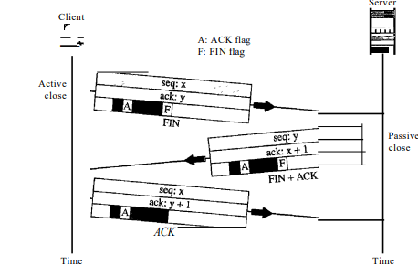
Connection Termination
Any of the two parties involved in exchanging data (client or server) can close the connection, although it is usually initiated by the client. Most implementations today allow two options for connection termination:
three-way handshaking
four-way handshaking with a half-close option
Three-Way Handshaking :

Slide 30
In a normal situation, the client TCP, after receiving a close command from the client process, sends the first segment, a FIN segment in which the FIN flag is set. Note that a FIN segment can include the last chunk of data sent by the client, or it can be just a control segment. If it is only a control segment, it consumes only one sequence number.
The server TCP, after receiving the FIN segment, informs its process of the situation and sends the second segment, a FIN + ACK segment, to confirm the receipt of the FIN segment from the client and at the same time to announce the closing of the connection in the other direction. This segment can also contain the last chunk of data from the server. If it does not carry data, it consumes only one sequence number.
The client TCP sends the last segment, an ACK segment, to confirm the receipt of the FIN segment from the TCP server. This segment contains the acknowledgment number, which is 1 plus the sequence number received in the FIN segment from the server. This segment cannot carry data and consumes no sequence numbers.

Slide 31
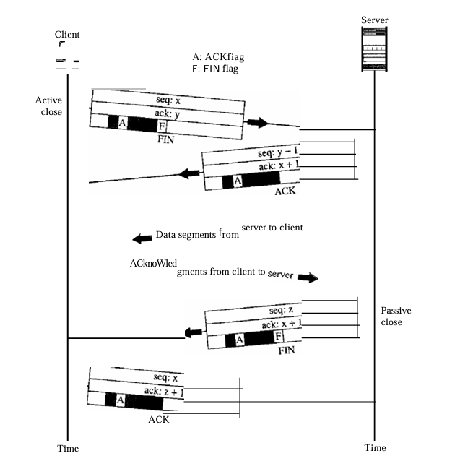
Half-Close :
In TCP, one end can stop sending data while still receiving data. This is called a half-close. Although either end can issue a half-close, it is normally initiated by the client. It can occur when the server needs all the data before processing can begin.
A good example is sorting. When the client sends data to the server to be sorted, the server needs to receive all the data before sorting can start. This means the client, after sending all the data, can close the connection in the outbound direction. However, the inbound direction must remain open to receive the sorted data. The server, after receiving the data, still needs time for sorting; its outbound direction must remain open.

Slide 32
Flow Control
TCP uses a sliding window, to handle flow control. The sliding window protocol used by TCP, however, is something between the Go-Back-N and Selective Repeat sliding window.

Slide 33
Congestion Control and Quality of Service
Congestion control and quality of service are two issues so closely bound together that improving one means improving the other and ignoring one usually means ignoring the other.
DATA TRAFFIC
The focus of congestion control and quality of service is data traffic. In congestion control we try to avoid traffic congestion. In quality of service, an appropriate environment for the traffic is created.
Traffic Descriptor
Traffic descriptors are qualitative values that represent a data flow.

Slide 34
Average Data Rate
The average data rate is the number of bits sent during a period of time, divided by the number of seconds in that period.
Average data rate = 𝑎𝑚𝑜𝑢𝑛𝑡 𝑜𝑓 𝑑𝑎𝑡𝑎/ 𝑡𝑖𝑚e
Peak Data Rate
The peak data rate defines the maximum data rate of the traffic.
Maximum Burst Size
The maximum burst size normally refers to the maximum length of time the traffic is generated at the peak rate.
Effective Bandwidth
The effective bandwidth is the bandwidth that the network needs to allocate for the flow of traffic. The effectiveness of the bandwidth is calculated based on average data rate, peak data rate, and maximum burst size.

Slide 35
Traffic Profiles
A data flow can have one of the following traffic profiles: constant bit rate, variable bit rate, or bursty.
Constant Bit Rate
A constant-bit-rate (CBR), or a fixed-rate, traffic model has a data rate that does not change. In this type of flow, the average data rate and the peak data rate are the same. The maximum burst size is not applicable. This type of traffic is very easy for a network to handle since it is predictable. The network knows in advance how much bandwidth to allocate for this type of flow.
Variable Bit Rate
In the variable-bit-rate (VBR) category, the rate of the data flow changes in time, with the changes smooth instead of sudden and sharp. In this type of flow, the average data rate and the peak data rate are different. This type of traffic is more difficult to handle than constant-bit-rate traffic

Slide 36
Bursty
In the bursty data category, the data rate changes suddenly in a very short time. It may jump from zero, for example, to 1 Mbps in a few microseconds and vice versa. This is the most difficult type of traffic for a network to handle because it is unpredictable.

Slide 37
CONGESTION
An important issue in a packet-switched network is congestion. Congestion in a network may occur if the load on the network-the number of packets sent to the network-is greater than the capacity of the network.
CONGESTION CONTROL
Congestion control refers to techniques and mechanisms that can either prevent congestion, before it happens, or remove congestion, after it has happened.
In general, we can divide congestion control mechanisms into two broad categories:
open-loop congestion control (prevention)
closed-loop congestion control (removal)

Slide 38
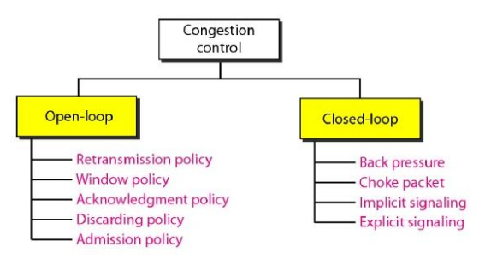

Slide 39
Open-Loop Congestion Control
In open-loop congestion control, policies are applied to prevent congestion before it happens. In these mechanisms, congestion control is handled by either the source or the destination.
Retransmission Policy :
Retransmission is sometimes unavoidable. If the sender feels that a sent packet is lost or corrupted, the packet needs to be retransmitted. Retransmission in general may increase congestion in the network. The retransmission policy and the retransmission timers must be designed to optimize efficiency and at the same time prevent congestion.
Window Policy
The type of window at the sender may also affect congestion. The Selective Repeat window is better than the Go-Back-N window for congestion control.

Slide 40
Acknowledgment Policy
The acknowledgment policy imposed by the receiver may also affect congestion. It can be designed in such a way that a receiver may send an acknowledgment only if it has a packet to be sent or a special timer expires. A receiver may decide to acknowledge only N packets at a time.
Discarding Policy
A good discarding policy by the routers may prevent congestion and at the same time may not harm the integrity of the transmission.
Admission Policy
An admission policy, which is a quality-of-service mechanism, can also prevent congestion in virtual-circuit networks. A router can deny establishing a virtual circuit connection if there is congestion in the network or if there is a possibility of future congestion.

Slide 41
Closed-Loop Congestion Control
Closed-loop congestion control mechanisms try to alleviate congestion after it happens. Several mechanisms have been used by different protocols.
Backpressure
The technique of backpressure refers to a congestion control mechanism in which a congested node stops receiving data from the immediate upstream node or nodes. This may cause the upstream node or nodes to become congested, and they, in turn, reject data from their upstream nodes or nodes. And so on.
Backpressure is a node-to-node congestion control that starts with a node and propagates, in the opposite direction of data flow, to the source. The backpressure technique can be applied only to virtual circuit networks, in which each node knows the upstream node from which a flow of data is corning.

Slide 42
Choke Packet
A choke packet is a packet sent by a node to the source to inform it of congestion. In the choke packet method, the warning is from the router, which has encountered congestion, to the source station directly. The intermediate nodes through which the packet has travelled are not warned.
Implicit Signalling
there is no communication between the congested node or nodes and the source. The source guesses that there is a congestion somewhere in the network from other symptoms. For example there is no acknowledgement for a while for the sent packets and the delay in acknowledgements.
Explicit Signalling
The node that experiences congestion can explicitly send a signal to the source or destination. The explicit signalling method, however, is different from the choke packet method. In the choke packet method, a separate packet is used for this purpose; in the explicit signalling method, the signal is included in the packets that carry data.

Slide 43
Backward Signalling: A bit can be set in a packet moving in the direction opposite to the congestion. This bit can warn the source that there is congestion and that it needs to slow down to avoid the discarding of packets.
Forward Signalling: A bit can be set in a packet moving in the direction of the congestion. This bit can warn the destination that there is congestion. The receiver in this case can use policies, such as slowing down the acknowledgments, to alleviate the congestion.

Slide 44
Congestion Control in TCP
TCP uses congestion control to avoid congestion or alleviate congestion in the network.
Congestion Window The sender window size is determined by the available buffer space in the receiver (rwnd) and the network. If the network cannot deliver the data as fast as they are created by the sender, it must tell the sender to slow down. The sender has the information of about the receiver advertised window size and the congestion window size.
The actual size of the window is the minimum of these two.
Actual window size=minimum (rwnd, cwnd)

Slide 45
Congestion Policy
TCP's general policy for handling congestion is based on three phases:
slow start
congestion avoidance
congestion detection.
In the slow-start phase, the sender starts with a very slow rate of transmission but increases the rate rapidly to reach a threshold. When the threshold is reached, the data rate is reduced to avoid congestion. Finally, if congestion is detected, the sender goes back to the slow-start or congestion avoidance phase based on how the congestion is detected.

Slide 46
Congestion Avoidance:
Additive Increase: TCP defines another algorithm called congestion avoidance, which undergoes an additive increase instead of an exponential one. When the size of the congestion window reaches the slow-start threshold, the slow-start phase stops, and the additive phase begins.
In this algorithm, each time the whole window of segments is acknowledged (one round), the size of the congestion window is increased by 1. To show the idea, this algorithm is applied to the same scenario as slow start, although it has been seen that the congestion avoidance algorithm usually starts when the size of the window is much greater than 1.
Congestion Detection: Multiplicative Decrease If congestion occurs, the congestion window size must be decreased. The only way the sender can guess that congestion has occurred is by the need to retransmit a segment. However, retransmission can occur in one of two cases: when a timer times out or when three ACKs are received. In both cases, the size of the threshold is dropped to one-half, a multiplicative decrease.

Slide 47
QUALITY OF SERVICE
Reliability Lack of reliability means losing a packet or acknowledgment, which entails retransmission. For example, it is more important that electronic mail, file transfer, and Internet access have reliable transmissions than telephony or audio conferencing.
Delay Source-to-destination delay is another flow characteristic. In case of telephone, audio conferencing, video conferencing, and remote log-in need minimum delay, while delay in file transfer or e-mail is less important.
Jitter
Jitter is the variation in delay for packets belonging to the same flow. For example, if four packets depart at times 0, 1, 2, 3 and arrive at 20, 21, 22, 23, all have the same delay, 20 units of time. On the other hand, if the above four packets arrive at 21, 23, 21, and 28, they will have different delays: 21,22, 19, and 24.
Bandwidth
Different applications need different bandwidths. In video conferencing there is a need for more bandwidth whereas in an e-mail, limited bandwidth is sufficient.

Slide 48
Techniques to Improve QoS
There are four common techniques available
Scheduling
Traffic shaping
Admission control
Resource reservation
Traffic Shaping
Traffic shaping is a mechanism to control the amount and the rate of the traffic sent to the network.
Two techniques can shape traffic:
Leaky bucket
Token bucket.

Slide 49
Leaky Bucket
If a bucket has a small hole at the bottom, the water leaks from the bucket at a constant rate as long as there is water in the bucket. The rate at which the water leaks does not depend on the rate at which the water is input to the bucket unless the bucket is empty. The input rate can vary, but the output rate remains constant.
Similarly, in networking, a technique called leaky bucket can smooth out bursty traffic. Bursty chunks are stored in the bucket and sent out at an average rate.

Slide 50
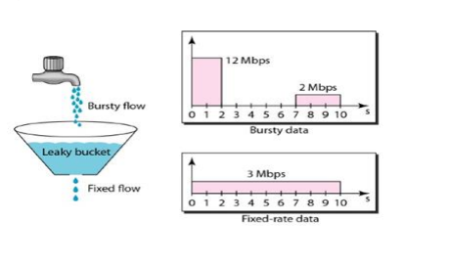
In the figure, let us assume that the network has committed a bandwidth of 3Mbps for a host. The use of the leaky bucket shapes the input traffic to make it conform to this commitment.
In above figure the host sends a burst of data at a rate of 12 Mbps for 2s, for a total of 24 Mbits of data.
The host is silent for 5s and then sends data at a rate of 2 Mbps for 3s, for a total of 6 Mbits of data. In all, the host has sent 30 Mbits of data in 10s.

Slide 51
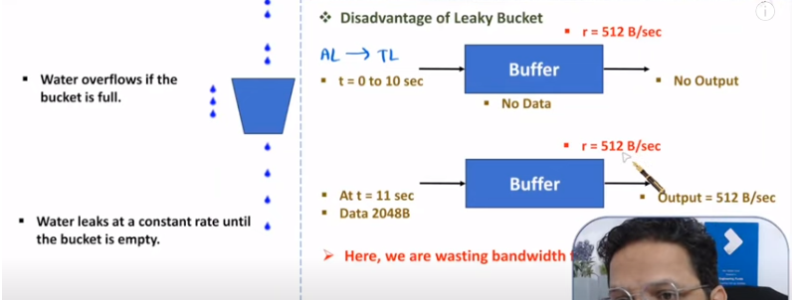
The leaky bucket smooths the traffic by sending out data at a rate of 3 Mbps during the same 10s. Without the leaky bucket, the beginning burst may cause the network by consuming more bandwidth than is set aside for this host. It has been seen that the leaky bucket may prevent congestion.

Slide 52
Token Bucket
The leaky bucket is very restrictive. It does not credit an idle host. For example, if a host is not sending for a while, its bucket becomes empty. Now if the host has bursty data, the leaky bucket allows only an average rate. The time when the host was idle is not taken into account.
On the other hand, the token bucket algorithm allows idle hosts to accumulate credit for the future in the form of tokens. For each tick of the clock, the system sends n tokens to the bucket. The system removes one token for every byte of data sent. For example, if n is 100 and the host is idle for 100 ticks, the bucket collects 10,000 tokens. Now the host can consume all these tokens in one tick with 10,000 bytes, or the host takes 1000 ticks with 10 bytes per tick. In other words, the host can send bursty data as long as the bucket is not empty. Figure 4.21 shows the idea.

Slide 53
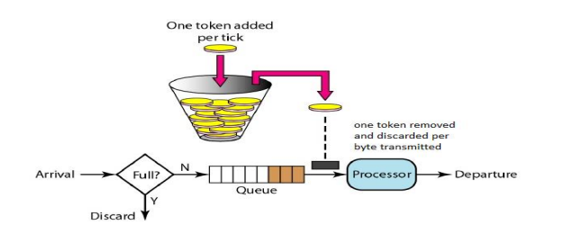

Slide 54
